Slide 1
Database Project
Movie Dataset With Java GUI Front End
By Yaqun Yu, Xiao Liang

Slide 2
Application Description
What this Application Can Do:
With an input table, it can list all element contained in this table
Movie can be added if it is not in table yet
Movies can be sorted based on movie’s title, year, director, studio or category
Rating can be added to specific movie based on title and year

Slide 3
Application Description
What we did:
1. Back End:
Use MySQL Build up a SQL database based on a Movie Dataset called Hitchcock Movies
Searching online for suitable dataset
Analyze and clean up raw data：the raw data contains lots of useless sample and strange format
Analyze inner relationship: Determine primary key, foreign key，FD and 4NF violation，decomposition.

Slide 4
Application Description
What we did:
2. Front End:
Use Java build up GUI in NetBeans. With consider of user experience.
Three classes: MOVIES_SQL, movies, moviesGUI
MOVIES_SQL: connect with netbeans,define functions, will be use in moviesGUI.
Movies: set up movie table in java
moviesGUI: GUI construction, link each buttons with their function.

Slide 5
Application Description
What we did:
3. Debug and Demo Record :
Demo recorded using Quicktime Player in Mac.
Demo upload on Youtube
Debug and organize our code
Record Demo about function implement
Upload our Demo on Youtube to share!

Slide 6
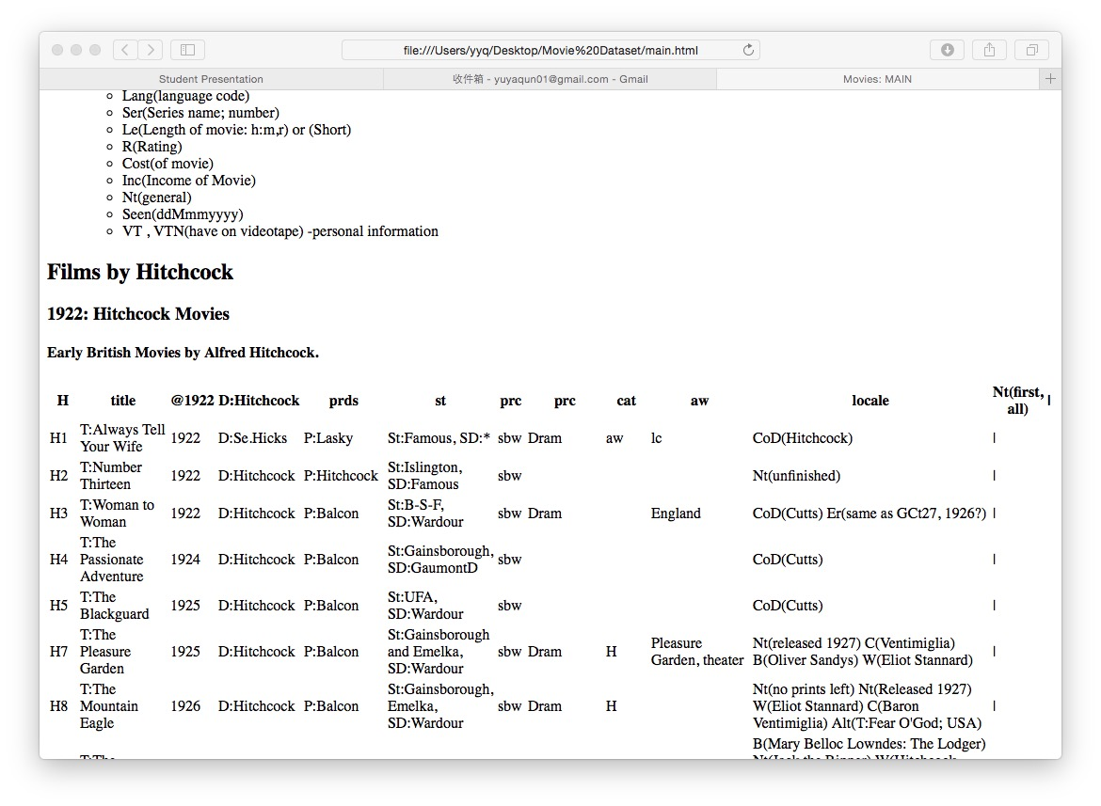
Raw data
Where it comes from:
Our database comes from an open-source database web set^{[1]}.
Table it contains:
Original: Four tables
(movies, director, studio and actors)
Updated: After decomposition of 4NF violation, we separate them into 5 tables
(movie, star, director, studio and actors)

Slide 7
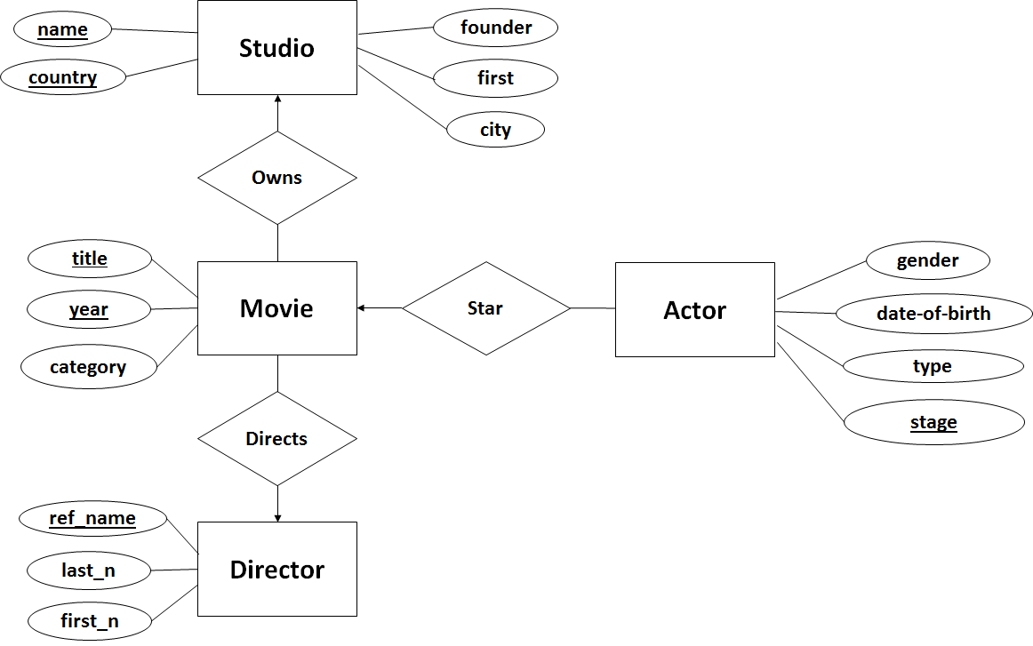
Back End Design^{[2]}
Determine each table’s distribution
Determine primary key, foreign key
Find FD & MVD for each table
Decomposition 4NF violation
Design E/R based on dataset
Write MySQL based on E/R

Slide 8
Implemented Functionalities^{[3]}
Add Movie Button
GUI
Add Panel
Adding Function:
Rating Function:
Add to List Button
MOVIES_SQL
addmovies function
Rate Movie Button
GUI
Rate Panel
Rate the movie Button
MOVIES_SQL
rateMovie
function
Notes:
Add: When source comes from btnAdd, it will trigger GUI go to Add panel, and when you input all information requested and hit “Add to List”, it will input the data we put in each field by execute the function addmovies defined in MOVIES_SQL: bu getting the text we input in 5 fields, and using setString with executeUpdate function
Rating: when hit Rate Movie button, trigger GUI goto rate panel; after input and hit “Rate the movie” Button, it recall rateMovie function which is defined in MOVIES_SQL and execute query in SQL

Slide 9
Implemented Functionalities^{[3]}
Movie List Button
GUI
List Panel
MOVIES_SQL
getmovie function
Listing Function:
Sorting Function:
Please Make a Selection
Combo Box
Choose
Select from our list
and Sort
Sort
Button
MOVIES_SQL
sortMovie
function
Notes:
Listing: hit movie list button, it will trigger GUI go to list panel(which is the current)and it will recall getmovie function in MOVIES_SQL.
Sorting: when hit sort movie button, trigger GUI goto sort panel; when select and hit Sort Button, it recall sortMovie function which is defined in MOVIES_SQL and execute orderby in SQL, it will order by the selected attribute.

Slide 10
Demo
Back End(MySQL): https://youtu.be/59jjGK9WQys
Front End (JAVA Netbeans IDE): https://youtu.be/AY80RQ0rOtM
Functions(4):
List Movie and Sort: https://youtu.be/LWB_lNBMouY
Add Movie and Rate Movie: https://youtu.be/J9EvCUmCpXE

Slide 11
Conclusion I
Dataset can be tricky and need to be analyzed with caution. Some tricks and strategies are needed to clean up raw data for the purpose of time saving.
Before making up table list, it is essential to find FD, MVD and 4NF violations. Otherwise it may surprise you at the end, make you spliting up tables and do the entire work over again.

Slide 12
Conclusion II & Future Work
E/R graphs are important for schema design. They are easier to change than actual SQL databases.
When doing implementation, details control need to be improved to achieve better understanding.
This GUI can be improved in the future adding multiple potential adavanced functions.

Slide 13
References
[1]Open Source Dataset:http://archive.ics.uci.edu/ml/
[2]Textbook
[3]Sample project: https://canvas.uw.edu/courses/1031245/pages/sample-project-with-backend-and-frontend

Slide 14
Q & A

Slide 15
The End Thank You!

